Slide 1
National Access Elsewhere Security Oversight Center (NAESOC)
UNCLASSIFIED
(FISWG Winter Security Training)
Ana Baker

Slide 2
What is an Access-Elsewhere Facility?
UNCLASSIFIED
Does not store classified information
All critical performance (classified or unclassified) related to their classified contract takes place at the government customer or other contractor locations

Slide 3
Agenda
UNCLASSIFIED
The Access Elsewhere Challenge
The DCSA Response (NAESOC)
NAESOC Questions Answered

Slide 4
Why Do We Need a NAESOC?
UNCLASSIFIED
Background
Impact of Legacy Approach
Approx. 12,200 cleared facilities in the NISP:
4,200 possessors and 8,000 non-possessors (Access Elsewhere - AE)
AE facilities:
Can include service providers, consultants, janitorial, government site SMEs, etc.
May or may not include Critical Technology components
Still require full NISPOM oversight actions
Did not receive appropriate prioritization
Legacy prioritization scheme favored possessors for security reviews
AE facilities most often are addressed by exception and usually after a major security event
AE facilities had unknown risk plus lack of communications from DCSA = potential for security breaches
Geographic + possessor-favored oversight resulted in minimal contact with AE facilities
Risk remained unknown; vulnerabilities not identified
AE facilities have been Ground Zero for recent security breaches
Edward Snowden, NSA contractor
Harold T. Martin, NSA contractor

Slide 5
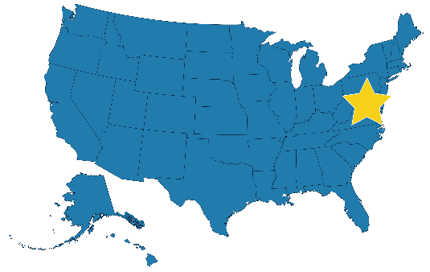
NAESOC
unclassified
The National Access Elsewhere Security Oversight Center (NAESOC) is a centralized office which provides consolidated, consistent oversight and security management for select facilities who do not possess classified information on-site (“access elsewhere”).
NAESOC Coordinates: Communications, guidance, and education to facilities and government partners.
NAESOC Provides: Continuous outreach, consistent direction.
NAESOC Results in: Improved communications, threat reporting, vulnerability identification, and vulnerability mitigation
More information: https://www.dcsa.mil/mc/ctp/naesoc/
Contact the NAESOC Knowledge Center: (888) 282-7682, option 7 (NAESOC)
01/22/2020
The centralized NAESOC provides the most effective method for supporting security oversight for select access elsewhere facilities in the NISP.
Flexible to mission updates and direction.
One voice for the director—one resource for the customer.
Leverages Continuous Evaluation and training approach for non-possessors.
unclassified

Slide 6
A National Solution – NAESOC Design
UNCLASSIFIED
National-level focus for AE facilities (non-geographic)
Teams provide active monitoring, risk identification, response capability, and proactive outreach & education support
Consolidated Staff
Industrial Security Representatives
Counterintelligence capability
Personnel Security direct support
Center for Development of Security Excellence (CDSE) partnership
Help Desk Model focused on issue (risk) identification and resolution.

Slide 7
UNCLASSIFIED
A National Solution – NAESOC Functions
The NAESOC manages:
Communications
Guidance
Education to NAESOC-assigned facilities and government partners
The NAESOC provides:
Continuous outreach
Consistent direction
This optimizes:
Communications
Threat reporting
Vulnerability identification
Vulnerability mitigation

Slide 8
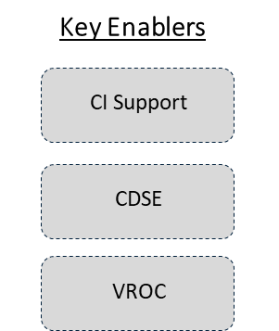
Customer-Focused, Risk-Design Processes
UNCLASSIFIED
NAESOC Chief
Continuous Vetting-
Facilities Team
Active Monitoring
& Engagement Team
Response Team
Provide Help Desk Functions
Triage incoming Comms
Maintain tracking & metrics
Review/maintain facility status
Process Changed Conditions/Material Changes
Review Trigger Events
Liaison with local Regions/FOs upon escalation
Respond to AIs
Conduct virtual targeted security reviews
Conduct active monitoring engagements (Continuous monitoring and virtual security reviews)
Identify and develop specialized training
Conduct Risk Response Triage
A Field Office with an enhanced design
Process flow enforces risk resolution through mitigation
Dedicated Key Enablers provide tailored support
UNCLASSIFIED

Slide 9
Benefit
UNCLASSIFIED
What can I expect from NAESOC Field Office?
A more targeted response. The NAESOC specifically works with access-elsewhere facilities, those not approved to store classified information at their location, and their requirements. This allows the team to focus on your needs without encumbering you with external, possessor-related communications and requirements.
Additional opportunities to interact with DCSA. Prioritized based on risk, not limited to size or geography, and associated with other facilities with similar requirements, you will receive more tailored, frequent, information streams from NAESOC.
Meaningful, tailored security education and training. DCSA, via the Center for the Development of Security Excellence (CDSE), provides a vast quantity and variety of educational and training venues and products. The NAESOC will assist in identifying and applying those specifically for non-possessors and track their effective application.

Slide 10
What’s In It for Me? (Answers to Your Questions)
UNCLASSIFIED
Will I be notified that my facility is assigned to NAESOC?
Yes. If your facility is assigned to the NAESOC, the NAESOC will send a “Welcome Letter” via email to the Facility Security Officer (FSO). Additionally, your FSO can check for your current status by checking the National Industrial Security System (NISS).

Slide 11
What’s In It for Me? (Answers to Your Questions)
UNCLASSIFIED
Will DCSA visit my facility?
Yes, if necessary. Your assignment includes risk criteria. If risk criteria are met, or if appropriate benefits can be provided by a face-to-face meeting with your facility, arrangements can be made for one.

Slide 12
What’s In It for Me? (Answers to Your Questions)
UNCLASSIFIED
Will my NISP requirements change under NAESOC oversight?
No. NAESOC provides oversight, support, and guidance consistent with NISPOM compliance requirements.

Slide 13
What’s In It for Me? (Answers to Your Questions)
UNCLASSIFIED
Are we receiving any ratings if we are part of the NAESOC?
The NAESOC provides oversight, support, and guidance consistent with NISPOM compliance requirements, so your most recent rating will remain until you have another assessment.
Your facility is subject to the same reviews as all others within the NISPOM and is updated based on your security posture and program.

Slide 14
What’s In It for Me? (Answers to Your Questions)
UNCLASSIFIED
Do I have to change all the past DD-254s forms to reflect NASESOC as the Cognizant office?
No. However, all new DD-254s must reflect NAESOC as the Cognizant Office.
NAESOC Field Office (Address):
Defense Counterintelligence and Security Agency (DCSA)
P.O. Box 644
Hanover, MD 21076

Slide 15
What’s In It for Me? (Answers to Your Questions)
UNCLASSIFIED
Who is my DCSA point of contact (POC) now that I am assigned to the NAESOC?
NAESOC Knowledge Center: 1(888) 282-7682, option 7 (NAESOC)
and/or email:
Include Facility Name & CAGE Code on the SUBJECT LINE:
For General Questions/Feedback: dcsa.naesoc.generalmailbox@mail.mil
To report Changed conditions: Create a changed condition package in NISS. If you have an upcoming changed condition or have questions regarding submitting a changed condition package, email the General Mailbox above.
To report Security Violations: NISS Messenger labeled “Message My ISR”

Slide 16
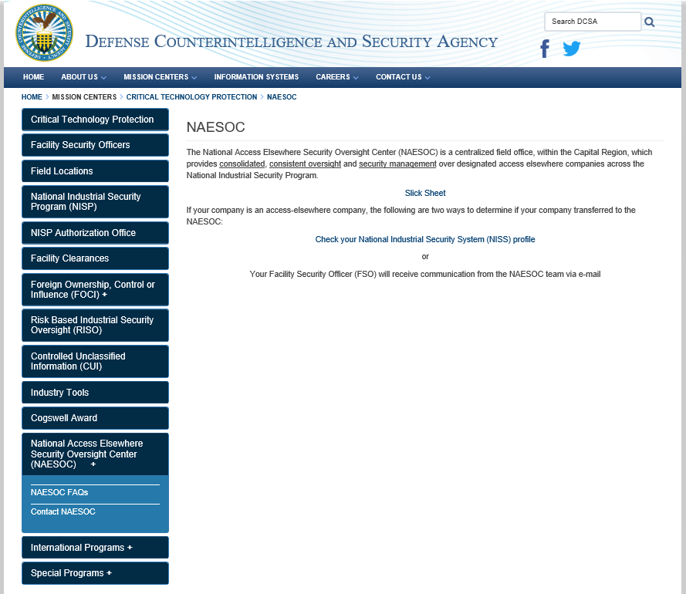
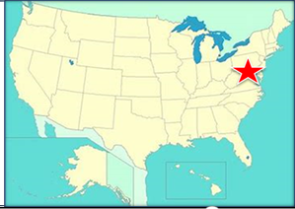
Contact Us
UNCLASSIFIED
QUESTIONS ?
https://www.dcsa.mil/mc/ctp/naesoc/

